Slide 1
Strategic Thinking and Coordination
Instructor: Dr. Tanya Rosenblat
Discussion Leader: Linfeng Li & Chen Wang

Slide 2

Visiting Scholar
Tanya Rosenblat
Associate Professor of Information, School of Information
Associate Professor of Economics, College of Literature, Science, and the Arts
University of Michigan
Main research interest: Experimental economics
Notes:
Recent research: Using experimental methods to explore the effects of physical attractiveness in the labor market, trust in societies and social learning

Slide 3
Learning Goals
Being able to represent strategic situations as games
Identify strategies
Strategy profiles and payoffs
Identify common classes of games (Cooperation, Coordination, Zero-sum)
Solve games using iterated deletion of strictly dominated strategies
Solve games using Nash Equilibrium
Become aware of Nash existence theorem

Slide 4
Author Overview
Linfeng & Chen

Slide 5
Networks, Crowds, and Markets
David Easley
Jon Kleinberg
Dept. of Economics, Information Science
Cornell University
Dept. of Computer Science
Cornell University
Notes:
David Easley
Economics of information; learning from endogenous data; market microstructure; evolution in games and markets
Jon Kleinberg
Algorithms that exploit the combinatorial structure of networks and information

Slide 6
Networks, Crowds, and Markets: Reasoning About a Highly Connected World

Slide 7

Behavioral Game Theory: Experiments in Strategic Interaction
Colin F. Camerer
Division of the Humanities and Social Sciences
Caltech
Notes:
Risky Choice; Behavioral Game Theory; Limited Strategic Thinking; Patience; Stock Market bubbles; Neuroscience of Economic Decisions

Slide 8
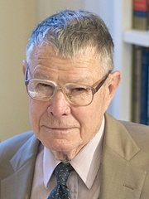
Bargaining, Communication, and Limited War
Thomas C. Schelling
Department of Economics
University of Maryland
Notes:
He was awarded the Nobel Prize in Economics in 2005, for “having enhanced our understanding of conflict and cooperation through game-theory analysis”

Slide 9
Some other Nobel Prize Winners in Game Theory
JeanTirole 2014
Alvin E. Roth 2012
Lloyd S. Shapley 2012
Roger B. Myerson 2007
Leonid Hurwicz 2007
Eric S. Maskin 2007
Robert J. Aumann 2005
William Vickrey 1996
James A. Mirrlees 1996
John C. Harsanyi 1994
…

Slide 10
A Short Game About Game Theory
Guess the number
Tanya(Linfeng & Chen)

Slide 11
Some Simple Games
Zero-Sum Games
Battle of the Sexes
Chicken or Hawk versus Dove
Prisoner’s Dilemma

Slide 12
Preliminary: identify strategies and payoffs in “Payoff Matrix”
 | Column Player Action 1 |  | Column Player Action 2
Row Player Action 1 | Payoff for Row player, | Payoff for Column Player | Payoff for Row player, | Payoff for Column Player
Row Player Action 2 | Payoff for Row player, | Payoff for Column Player | Payoff for Row player, | Payoff for Column Player
Notes:
Plan for recording responses to simple games
a) Split 12 people into 2 groups;
b) Give unspecified opponent strategies (don't pair people into groups of twos)
c) Draw the demo of the games on the board, and keep recording people's choice in their role.
d) Rise hands and document on board, for each game.

Slide 13
Zero-Sum Games
 | Head | Tail
Head | 1, -1 | -1, 1
Tail | -1, 1 | 1, -1
Notes:
Example: matching pennies. If row player chooses what column player chooses, then row player wins. If not, column player wins.
Plan for recording responses to simple games
a) Split 12 people into 2 groups;
b) Give unspecified opponent strategies (don't pair people into groups of twos)
c) Draw the demo of the games on the board, and keep recording people's choice in their role.
d) Rise hands and document on board, for each game.

Slide 14
Battle of the Sexes (a coordination game)
 | Football Game | Opera
Football Game | 2, 1 | 0, 0
Opera | 0, 0 | 1, 2
Notes:
Plan for recording responses to simple games
a) Split 12 people into 2 groups;
b) Give unspecified opponent strategies (don't pair people into groups of twos)
c) Draw the demo of the games on the board, and keep recording people's choice in their role.
d) Rise hands and document on board, for each game.

Slide 15
Chicken or Hawk versus Dove (an anti-coordination game)
 | Tough | Chicken
Tough | -1, -1 | 10, 0
Chicken | 0, 10 | 5, 5
Notes:
Plan for recording responses to simple games
a) Split 12 people into 2 groups;
b) Give unspecified opponent strategies (don't pair people into groups of twos)
c) Draw the demo of the games on the board, and keep recording people's choice in their role.
d) Rise hands and document on board, for each game.

Slide 16
Prisoner’s Dilemma (a cooperation game)
 | Cooperate | Defect
Cooperate | 3, 3 | -1, 4
Defect | 4, -1 | 0, 0
Notes:
Plan for recording responses to simple games
a) Split 12 people into 2 groups;
b) Give unspecified opponent strategies (don't pair people into groups of twos)
c) Draw the demo of the games on the board, and keep recording people's choice in their role.
d) Rise hands and document on board, for each game.

Slide 17
Any questions on the structure of the games?

Slide 18
Networks, Crowds, and Markets
Intro to Game theory
& One solution concept: Iterated Deletion
Tanya

Slide 19
Use Iterated Deletion to solve Prison Dilemma
 | Cooperate | Defect
Cooperate | 3, 3 | -1, 4
Defect | 4, -1 | 0, 0

Slide 20
We can solve something more complex!
h | A | B | C | D
A | 5, 2 | 2, 6 | 1, 4 | 0, 4
B | 0, 0 | 3, 2 | 2, 1 | 1, 1
C | 7, 0 | 2, 2 | 1, 5 | 5, 1
D | 9, 5 | 1, 3 | 0, 2 | 4, 8

Slide 21
However, there are games that Iterated Deletion cannot solve
Battle of the Sexes
 | Football Game | Opera
Football Game | 2, 1 | 0, 0
Opera | 0, 0 | 1, 2

Slide 22
Break

Slide 23
Networks, Crowds, and Markets
Another solution concept: Nash Equilibrium
Tanya

Slide 24
Another Game
Tanya

Slide 25
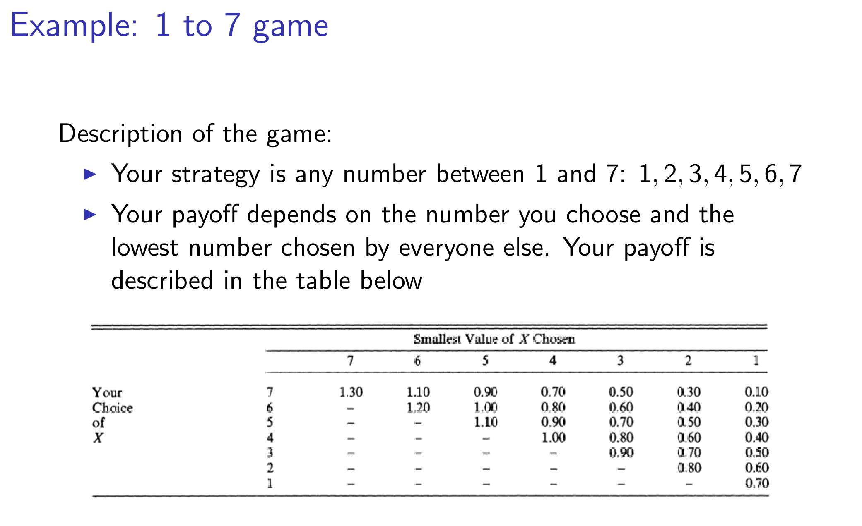

Slide 26
Behavioral Game Theory
Tanya

Slide 27
Bargaining, Communication, and Limited War
Notes:
2. Possible answer:
(For example: credible through will reinforce a unilateral strategy)

Slide 28
Bargaining, Communication, and Limited War
Focal strategy according to social norms;
How would communication affect the structure of the game?
Or trustworthiness?
How would the number of equilibria affect strategic decision making?
Any other way of eliminating possible confusions?
Notes:
2. Possible answer:
(For example: credible through will reinforce a unilateral strategy)

Slide 29
Open Question

Slide 30
Reflection

